Slide 1
HEALTH CARE CHATBOT SYSTEM
PROJECT GUIDE:
TEAM MEMBERS :NEEL PATEL
SOLANKI DHRUV
DILEN PANCHAL
MIRAJ SUTARIYA

Slide 2
ABSTRACT
To lead a good life healthcare is more important. But it is very difficult to obtain the consultation with the doctor in case of any health issues. The proposed idea is to create a health care chatbot system using Artificial Intelligence that can diagnose the disease and provide basic details about the disease before consulting a doctor. The system provides text (or)voice assistance that means user can use own convenient language .Bot will provides which type of disease you have based on user symptoms and appeared doctor details respective to user disease. The chatbot will clarify the users symptoms with serious of questions and the symptom conformation will be done. The disease will be categorized as minor and major disease. Chatbot will reply whether it is a major or minor disease .if it is a major disease user will be suggested with the doctor details for further treatment.

Slide 3
INTRODUCTION
Now a days,health care is very important in our life.Todays people are busy with their works like office works, home works and more addicted to Internet.They are not concerned about their health .So they avoid to go in hospitals for small problems.it may become a major problem.
So we can provide an idea is to create a health care chatbot system using AI that can diagnosis the disease and provide basic information about the disease before consulting a doctor.Which helps the patients know more about their disease and improves their health.User can achieve the all kind of disease information.

Slide 4
The system application uses question and answer protocol in the form of chatbot to answer user queries.The response to the question will be replied based on the user query.The significant keywords are fetched from the sentence and answer to those sentences.If match is discovered or significant answer will be given or similar answers will be displayed.
Bot will diagnosis which type of disease you have based on user symptoms and also gives doctor details of particular disease.It may reduce their health issues by using this application system.
The system is developed to reduce the healthcare cost and time of the users as it is not possible for the users to visit the doctors or experts when immediately needed.

Slide 5
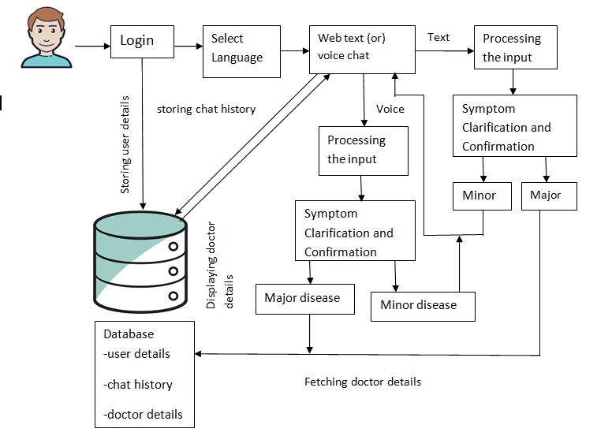
ARCHITECTURE:
user

Slide 6
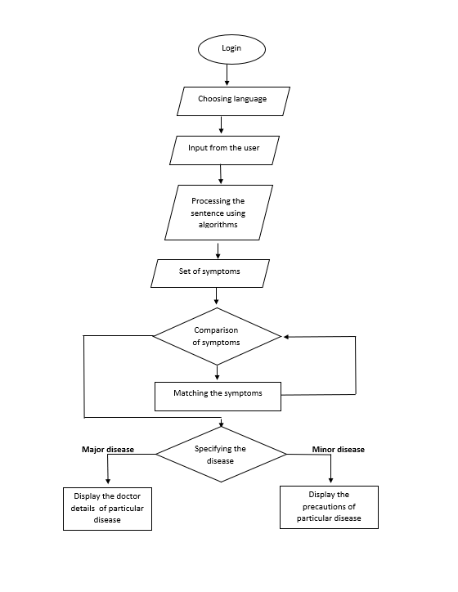
DATA FLOW DIAGRAM:

Slide 7
ALGORITHMS:
We are using two algorithms to implement health care chatbot system.
TF-IDF(Term frequency-inverse data frequency)
Cosine similarity algorithm

Slide 8
N-gram algorithm:
N-Grams are one way to help machines understand a word in the content to get a better understanding of word.
N-gram is a contiguous sequence of n-items from a given sample of text. N-items means we can have two items, three items and so on. So , it is a contiguous sequence of some items.it helped to predicting the next words in a sentence.
Items can be characters , words , sentences. When n is 2 then we can call it as bigrams and n is 3 then we can call it as trigrams.Based on sentence we can change the value of ‘n’.

Slide 9
Example1:I am suffering from fever.
Example2:I am suffering from headache.
n=3(trigram)
example1:
(‘I’, ‘am’, ‘suffering’ ) ->I am suffering
(‘am’, ‘suffering’, ‘from’) ->I am suffering from
(‘suffering’, ‘from’, ‘fever’) ->I am suffering from fever
example2:
(‘I’, ‘am’, ‘suffering’ ) ->I am suffering
(‘am’, ‘suffering’, ‘from’) ->I am suffering from
(‘suffering’, ‘from’, ‘headache’) ->I am suffering from headache.

Slide 10
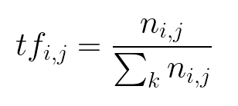
TF-IDF:
Term frequency( tf ):
Often times, when building a model with the goal of understanding text, you’ll see all of stop words being removed. Another strategy is to score the relative importance of words using TF-IDF.
The number of times a word appears in a document divided by the total number of words in the document. Every document has its own term frequency.

Slide 11
Exmaple1: I am suffering from fever.
Example2:I am suffering from headache.
Tf=number of occurances/number of words in document
Example1: Example2:
Tf1= 1/5=0.2 Tf1= 1/5=0.2
Tf2=1/5=0.2 Tf2=1/5=0.2
Tf3=1/5=0.2 Tf2=1/5=0.2
Tf4=1/5=0.2 Tf2=1/5=0.2

Slide 12
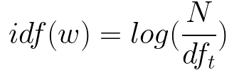
Inverse Document Frequency (IDF):
The log of the number of documents divided by the number of documents that contain the word w. Inverse data frequency determines the weight of rare words across all documents in the corpus.

Slide 13
Exmaple1: I am suffering from fever.
Example2:I am suffering from headache.
Idf=log(number of documents/number of documents contain a word)
Idf(I) = log(2/2) = 0
Idf(am) = log(2/2) = 0
Idf(suffering) = log(2/2) = 0
Idf(from) = log(2/2) = 0
Idf(fever) = log(2/1) = 0.301
Idf(headache)= log(2/1) = 0.301

Slide 14
Tf idf = Tf*idf
documents | I | am | suffering | from | fever | Headache
document1 | 0.2*0=0 | 0.2*0=0 | 0.2*0=0 | 0.2*0=0 | 0.2*0.301= 0.012 | 0
document2 | 0.2*0= 0 | 0.2*0=0 | 0.2*0=0 | 0.2*0=0 | 0 | 0.2*0.301= 0.012

Slide 15
Cosine similarity algorithm:
Cosine similarity is a measure of similarity between two non-zero vectors of an inner product space that measures the cosine of the angle between them.
The technique is also used to measure cohesion within clusters in the field of data mining.

Slide 16
EXISTING system
Many of the existing systems have live chats through texts and some limitation such as there is no instant response given to the patients they have to wait for experts acknowledgement for a long time. Some of the processes may charge amount to perform live chat or telephony communication.

Slide 17
Proposed system
In our proposed system the user can chat with the bot regarding the query through voice or text. • The system uses an expert system to answer the queries • User can also view the available doctors and booking appointments for that particular disease. • This system can be used by the multiple users to get the counselling sessions online. • The data of the chatbot stored in the database in the form of pattern-template. • Bot will provide analgesics and food suggestions that means which food you have to take based on the disease

